Slide 1

Bio Interphase Team B -
AI Guided Predictions of Bat Populations from White-Nose Syndrome
AI Studio Final Presentation

Slide 2

Agenda
Team Introductions
Meet Our Team
AI Studio TA and Challenge Advisor
Project Overview
Goals
Business Impact
Our Approach
Resources Used
Data Understanding & Data Preparation
Data Sources
Feature Engineering
Modeling & Evaluation
Model Selection
Models Comparison
Visualization
Conclusions
Notes:
Do we need this?

Slide 3

Introductions

Slide 4


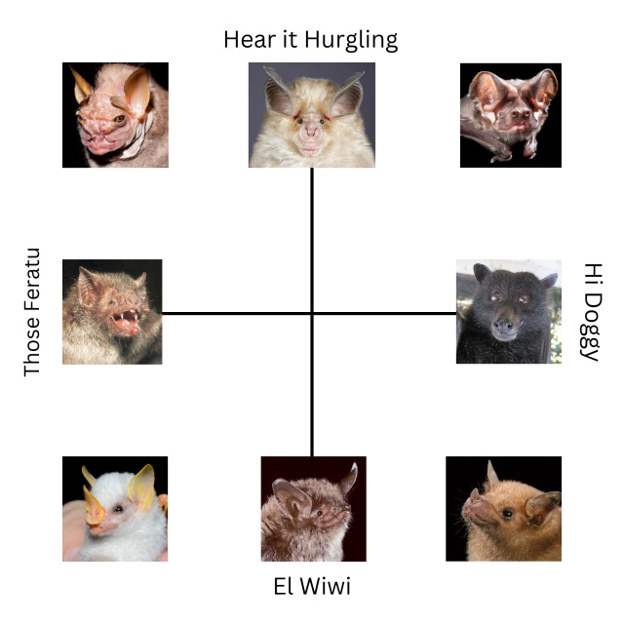


Meet Our Team!
Annissa Mu
Margarita Kholostova
Dov Zipursky
Gwen Liu

Slide 5
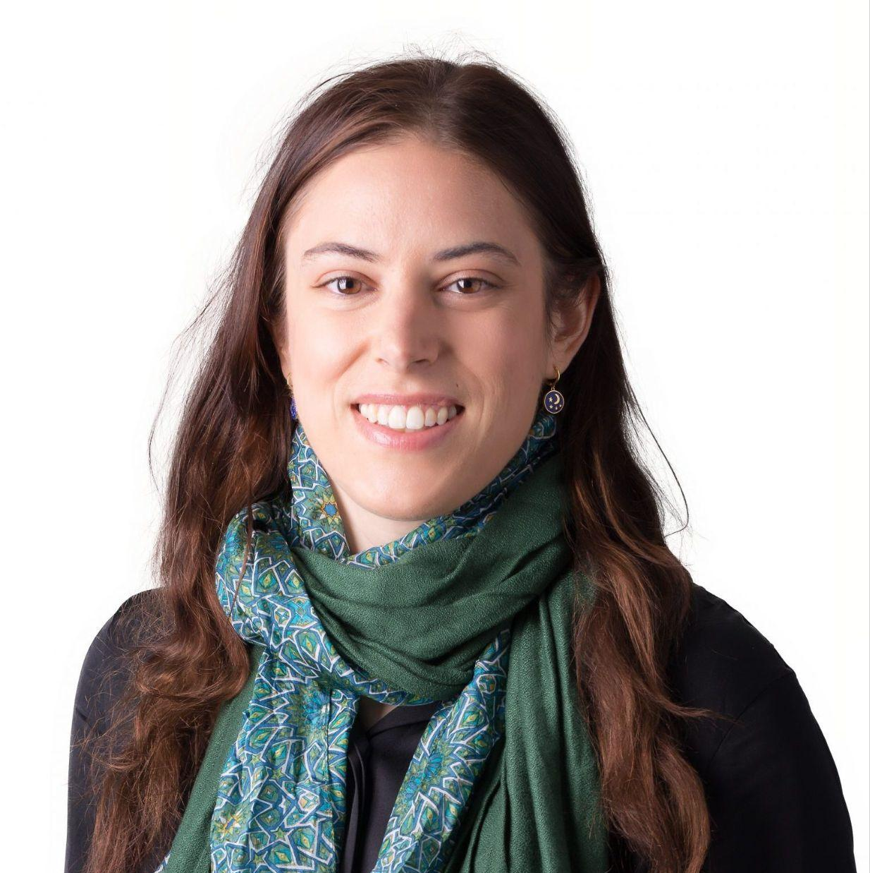

Our AI Studio TA and Challenge Advisors
<insert jpg>
<insert jpg>
Leandra Marie Tejedor AI Studio TA
Noah Snyder Challenge Advisor

Slide 6
AI Studio Project Overview

Slide 7
“
Your mission, should you choose to accept it, is to create an ML predictive model for bat population decline throughout North America using publicly available datasets related to bat populations, bat acoustic information, and other easily accessible climate data.
Notes:
Dov?

Slide 8
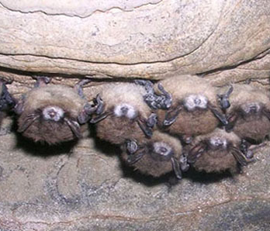
Bat Population Decline
White Nose Syndrome (WNS)
Disease of hibernating bats caused by the fungus Pseudogymnoascus destructans spreading across North America
First detected in New York in 2006
Killed over 90% of three NA bat species
Notes:
Spreading across north america by human traffic(?)
Congests bats making them wake up from hibernation early, making them expend more energy than they have reserved for hibernation
Killed 6 million bats

Slide 9
Project Goal:
Purpose:
To predict the presence, absence, or risk of White-Nose Syndrome (WNS) in various U.S. regions.
Model Focus:
Identifying areas with active WNS in bats.
Detecting regions where bats are positive for Pseudogymnoascus destructans (PD) fungus but do not show symptoms of WNS.
Data Utilization:
Leveraging data from 2006 to 2023.
Incorporating climate data and bat habitat information for accurate predictions.
Notes:
Margo

Slide 10
Potential Project Impact
By improving how conservation groups use their resources, we can better protect bat populations. This can lead to more partnerships and funding for businesses that work in wildlife conservation, making their efforts more effective and impactful.
Protecting bats can help farms and businesses that grow crops. Bats eat lots of pests naturally, so if there are more bats, farmers will not need to rely on as many chemicals to keep bugs away from their crops
The findings from our model could be useful for biotech and pharmaceutical companies. They can use this information to develop new ways to treat or prevent White-Nose Syndrome in bats. This could also lead to new opportunities for research and development funding in these fields.
Notes:
Margo

Slide 11
Our Approach
Data Hunt and Exploration
Finding data, both independently and from the sources our CA provided, and understanding the components of that data.
The Beginning of the End
With a dataset finally intact, we start to build models while learning to handle spatial and temporal data
October
December
September
November
The Continued Search and the Beginning of the Merge
Still trying to find more data, we start to merge what we have into a useable set, select a label, and narrow down potential features and model algorithms.
Model and Delivery
We finalize a model and a visualization for our predictions

Slide 12


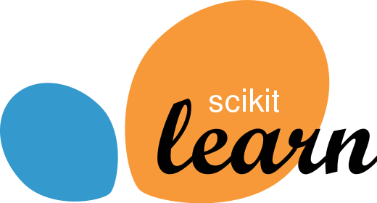
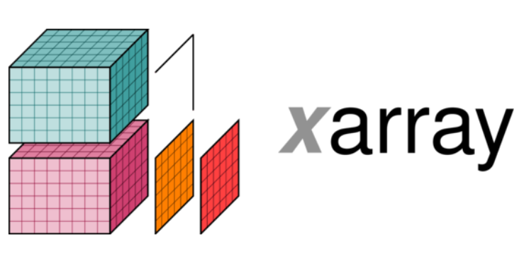
Resources We Leveraged
Workflow: Google Collab, Trello
Data Preparation: Xarray, Pandas
Models: Scikit Learn
Notes:
Gwen

Slide 13
Data Understanding & Data Preparation
Notes:
Gwen & Dov

Slide 14
Locating and Accessing Data Sources:
Challenges
One of the major challenges of this project was finding relevant data.
Data tends to fall into one of these categories:
Incomprehensive data sets
Format Unfit for Analysis
Restricted or Classified Information
The data we did have contained primarily locations, dates, species of bats affected, numbers related to the amount of bats affected, and whether or not there was WNS present at the site.

Slide 15
Locating and Accessing Data Sources:
Successes
We decided to choose a label and merge our data, even though we didn’t have the data we wanted.
Having a label was helpful, since now we had a real target. We managed to track down a dataset with climate data, both real recorded data a predicted data for the future, with a variety of predictive models to choose from.
The key for this was to stop looking for specific, probably classified data, and shoot for general but still possibly correlated data.

Slide 16
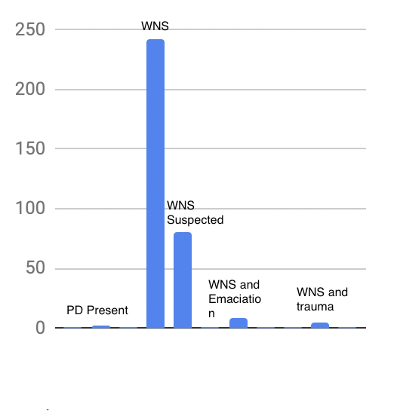
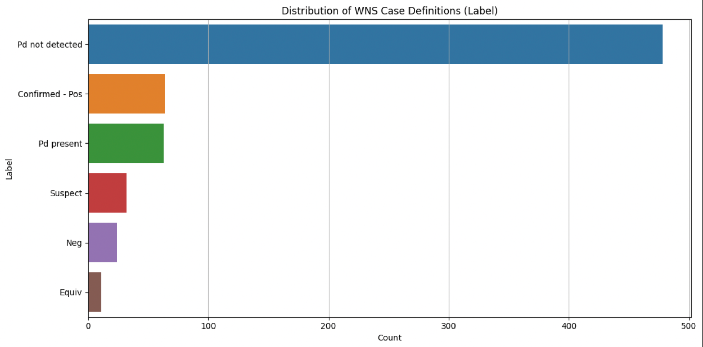
Data Engineering
Our sample data was fairly balanced between examples where WNS was detected and examples where it wasn’t
One of the decisions we had to make was which items should be in the three categories we decided on; WNS, Negative, and Fungus Detected.

Slide 17
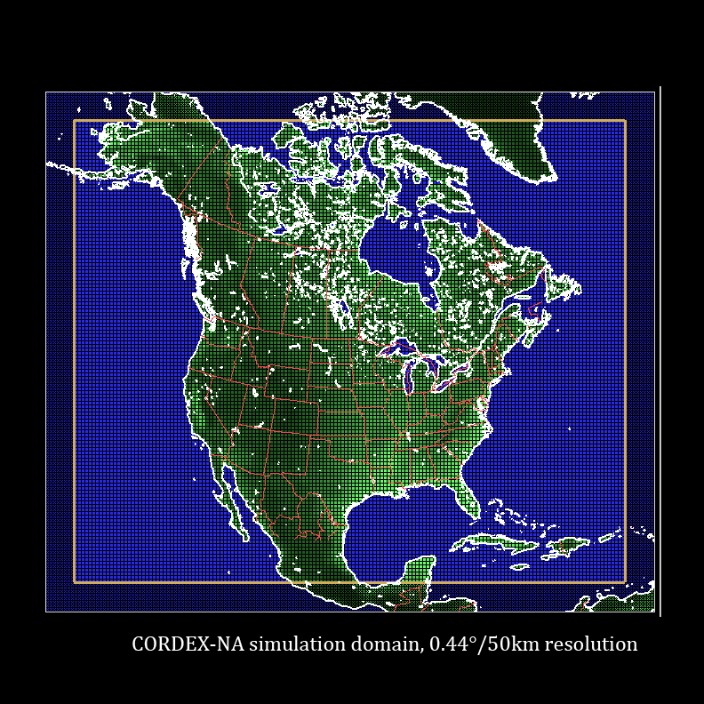
Feature Engineering
We used climate data from The North American Cordex Program
Utilizes regional climate models to simulate conditions (2006-2100)
Predictions at daily frequencies
Spatial resolution of 0.22 degrees/25 km
The features we extracted:
Temperature: annual mean, max, min
Humidity: annual mean, max, min
Precipitation: annual mean, max, min
Surface Downwelling Shortwave Radiation (solar radiation): annual mean
Feature engineering consisted of scaling the data to enhance compatibility with models employed and introducing a distance parameter to account for spatial aspect of our data
We calculated distance between points and the nearest previous disease detection using the Haversine formula

Slide 18
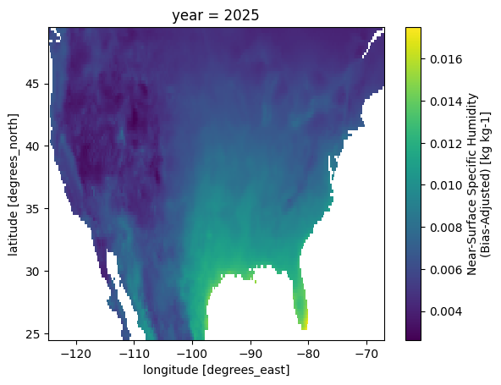
Humidity Trends: 2025
Notes:
Specific humidity is defined as the mass of water vapor per unit mass of moist air. (kg kg^-1)

Slide 19
Modeling & Evaluation

Slide 20

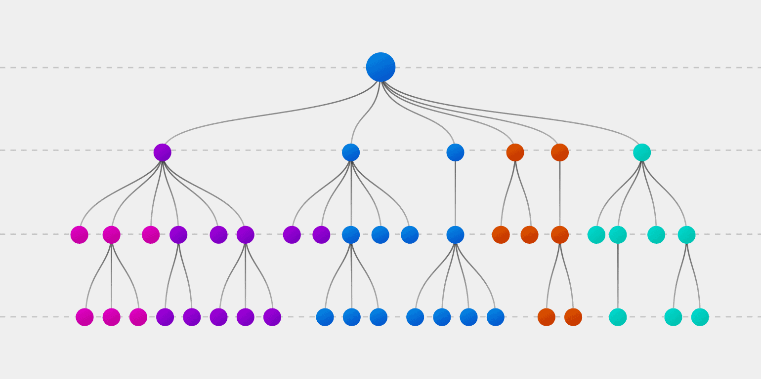
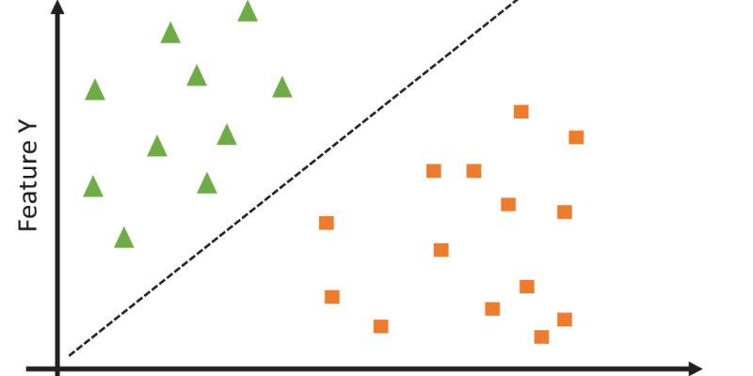
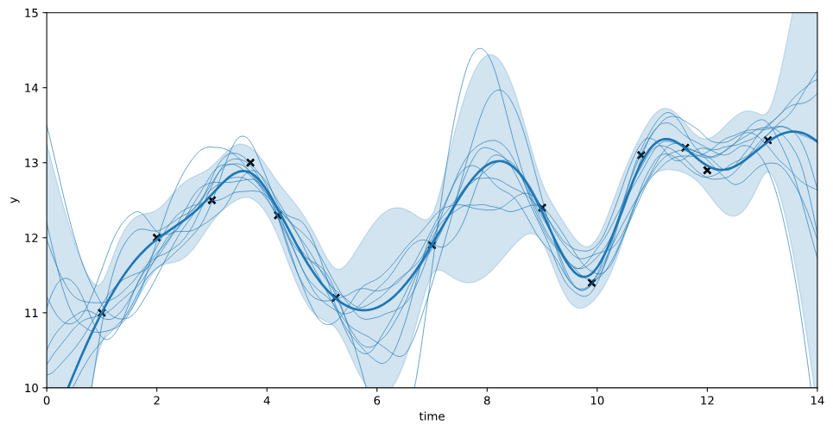
Paste an image
Model Selection
Decision Trees
Support Vector Machines
Gaussian Process

Slide 21

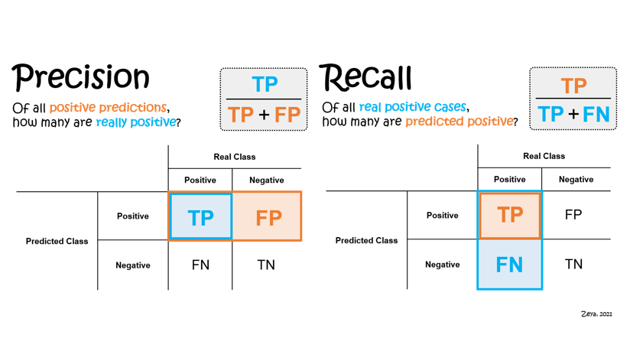
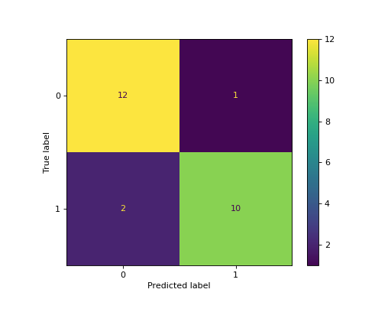
Key Terms for Evaluating Models
Precision and Recall:
Confusion Matrix:
*We want to predict conservatively, so reducing False Positives (cases where WNS is predicted when actually there is no presence of WNS)

Slide 22
Decision Trees - Model Tuning
Step 1: Split training and test data by year 2020
Step 2: Decision Tree trained and evaluated (precision, recall)
Step 3: Hyperparameter tuning (GridSearchCV)
Notably the model with highest accuracy used:
Classweight set to ‘balanced’ to handle imbalance of positive and negative cases
Depth of tree set to ‘None’ →risk of overfit especially on small dataset
Minimum samples per leaf set to 1 - suggests highly specific tree

Slide 23
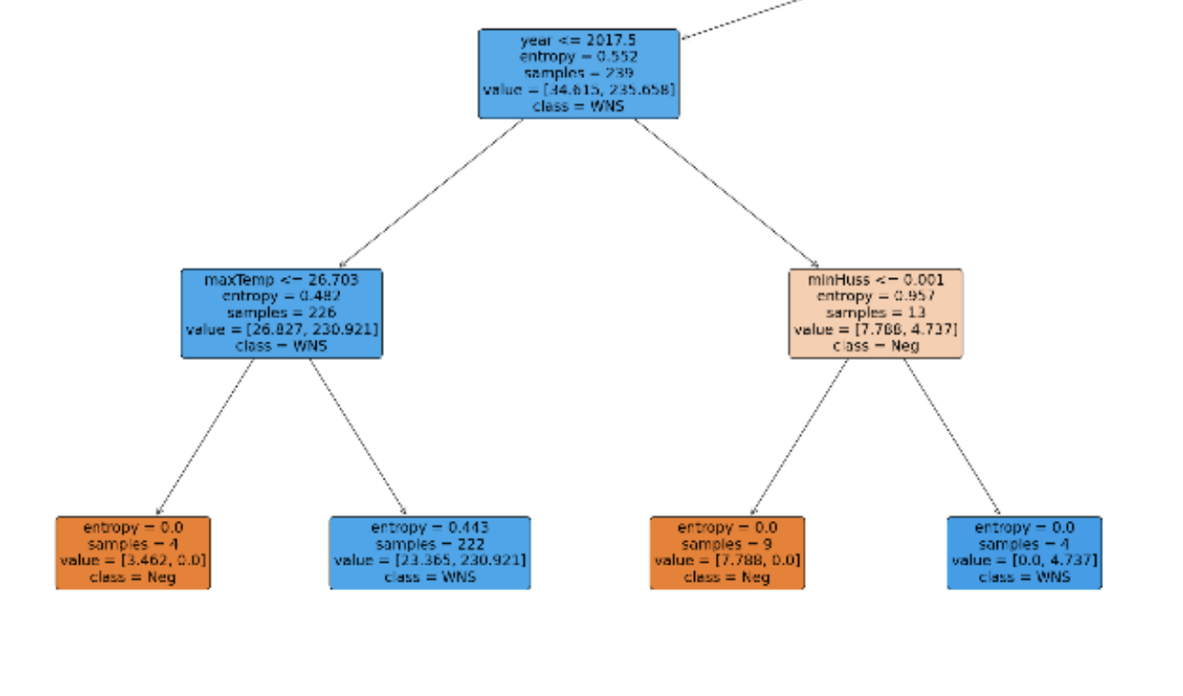
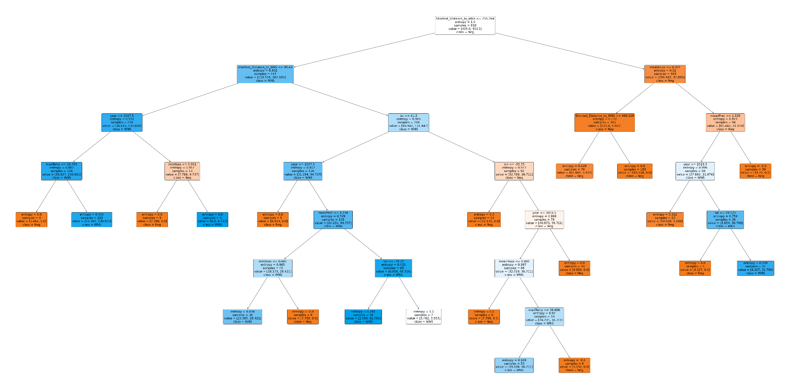
tbd
Decision Tree Plot

Slide 24
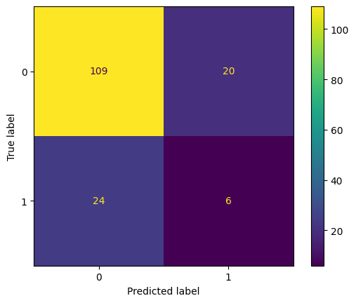
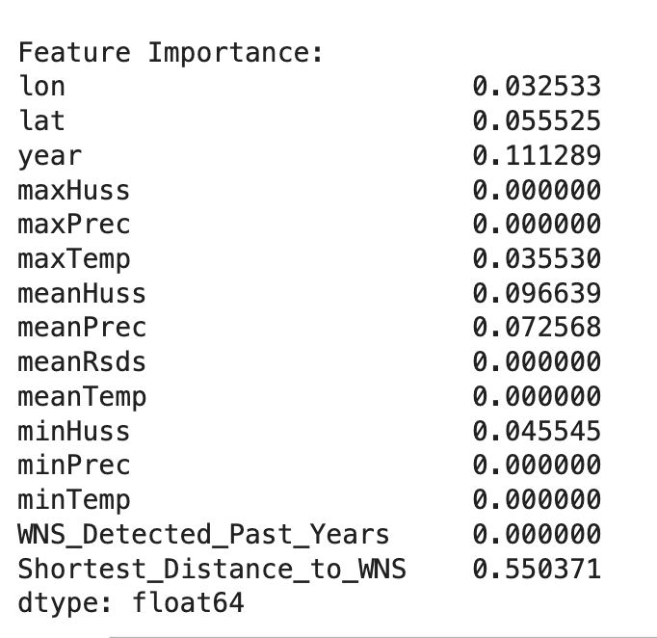
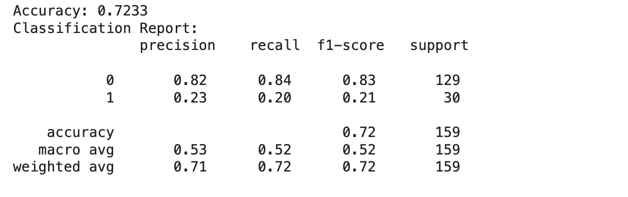
bd
Confusion Matrix
Decision Trees - Visual
Some variables assigned 0 significance in individual decision tree
(negative)
(WNS)

Slide 25
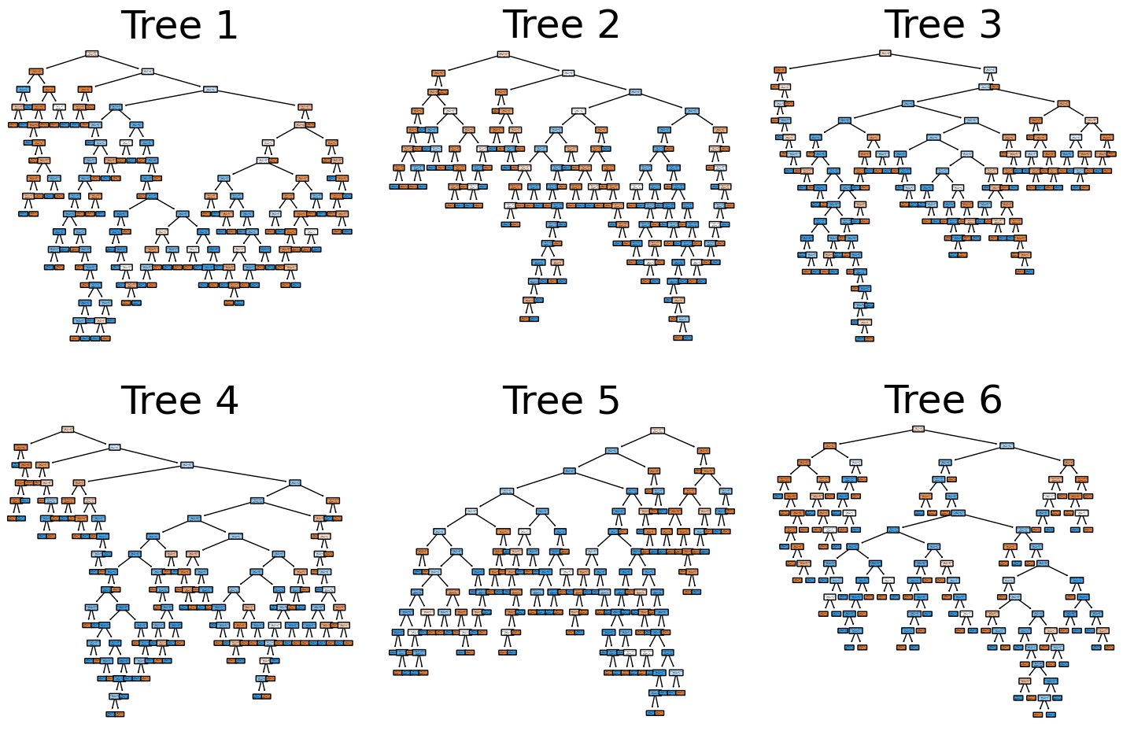
Decision Trees - Random Forest
We transitioned to a random forest model due to concern of overfitting with the small dataset and high number of features
Better performance than individual decision tree
Robust to outliers and noise
Better at handling high-dimensional data (high number of features)

Slide 26
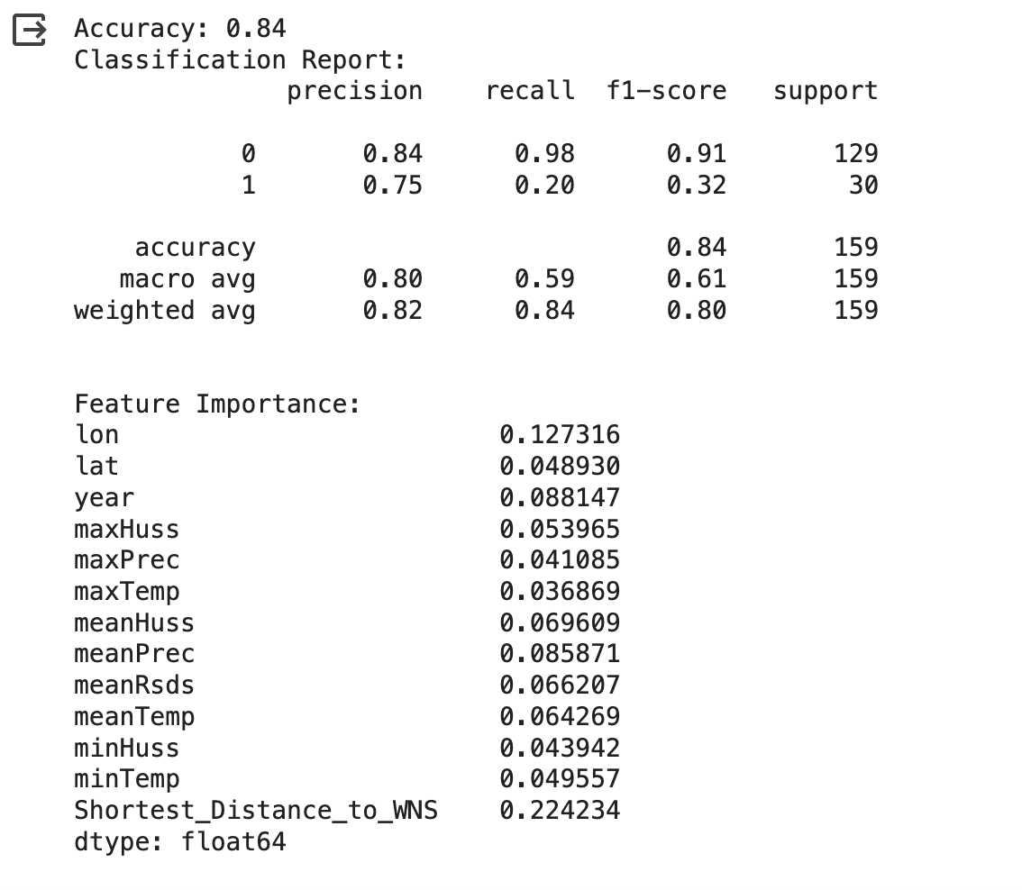
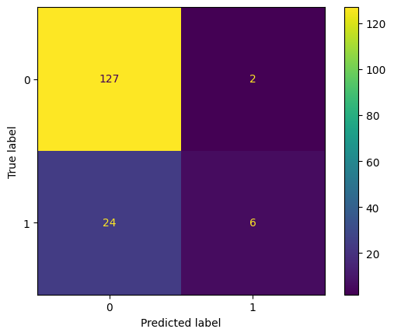
Feature | Importance Score (0-1)
Distance to previous detection | 0.224
Longitude | 0.127
Mean Precipitation | 0.085
Mean Humidity | 0.069
Mean Solar Radiation | 0.066
Mean Temperature | 0.064
(negative)
(WNS)

Slide 27
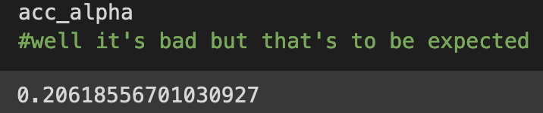
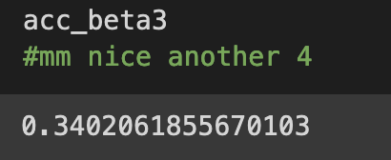
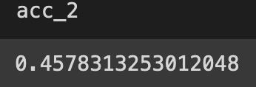
Support Vector Machine - Model Tuning
The process of attempting to improve the SVM was simple, if a bit fruitless.
Step 1: Scaling. SVMs require their data to be scaled to work well.
Step 2: Seeing what it does with no special settings:
It did not do anything impressive →
Step 3: Do some grid searching and give it better
parameters. Also changed the data a little. →
Step 4: Remove a category to make it binary,
creating this improvement →
Step 5: Realize that this
number is suspicious…

Slide 28
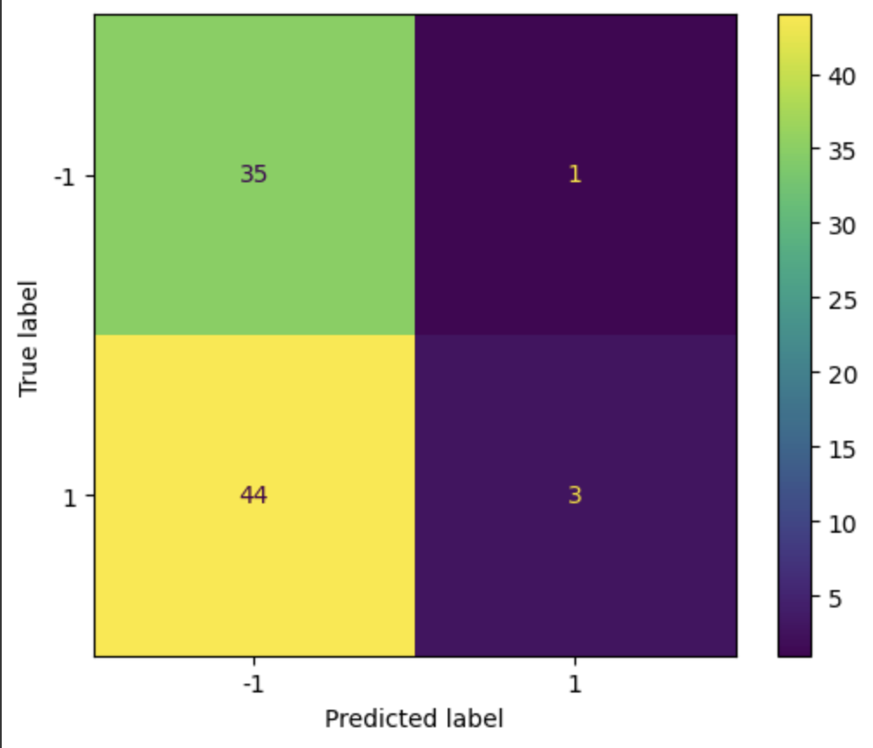
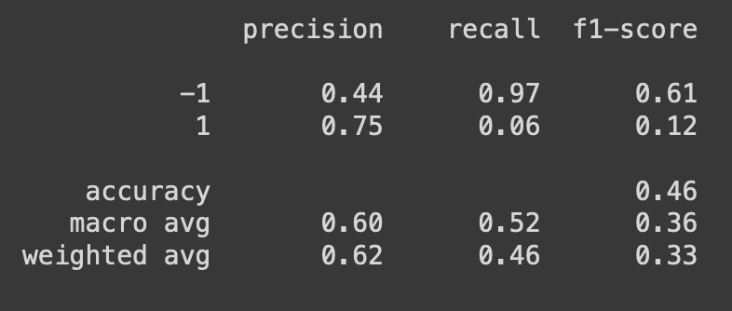
-1 = negative, 1 = WNS
*This model is flipping a coin, which is why the accuracy is roughly ⅓ with three classes and ½ with two classes.
*The ideal version of this diagram has a yellow diagonal from the top left to the bottom right.
Notes:
This model does not know what it is doing, and is probably just not compatible with this data set and the distribution of the data.
This model should also not be included in an ensemble, as it is unlikely to meaningfully help other models by blindly guessing.
SVMs are not useful for this problem, but they are still cool and you should appreciate them regardless.

Slide 29
Gaussian Process- Model Tuning
Goal: Identify areas in our dataset that have high probabilities of WNS
Step 1: Split training and test data by year 2020
Step 2: Gaussian Process Model created with spatial and temporal Kernels used to capture spatial and temporal aspects of data
Step 3: Training model
Step 4: Transforming Predictions (probabilities) to binary classifications with a threshold
0.5 threshold means probabilities above 0.5 are classified as 1 (WNS detection), while those below are classified as the negative class 0 (No WNS)
Scaling this parameter changes precision/recall balance…

Slide 30
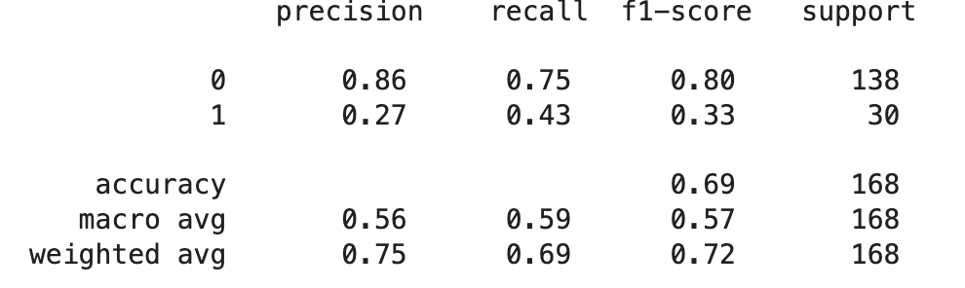
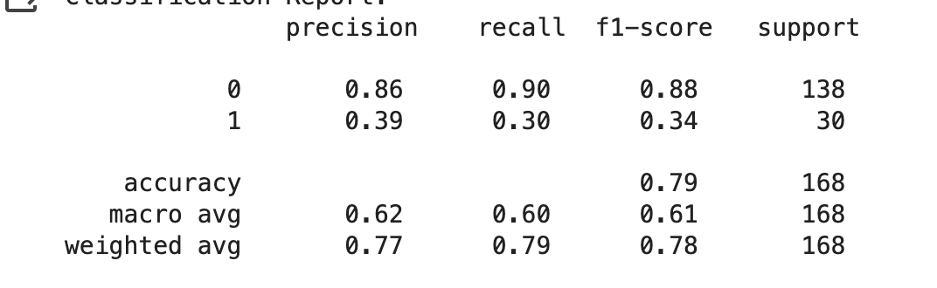
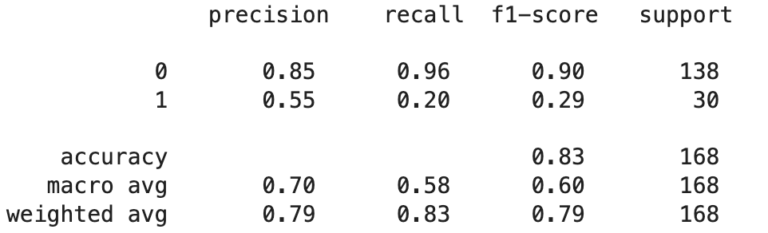
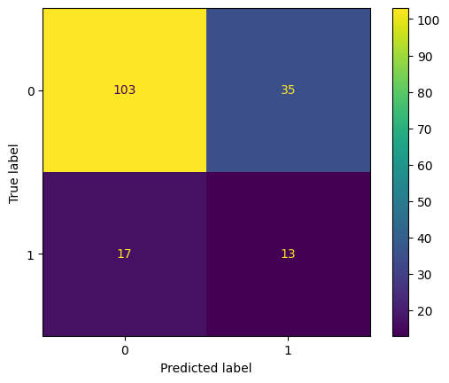
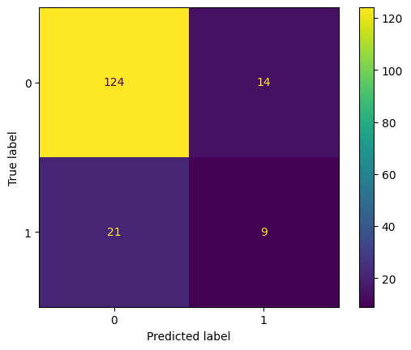
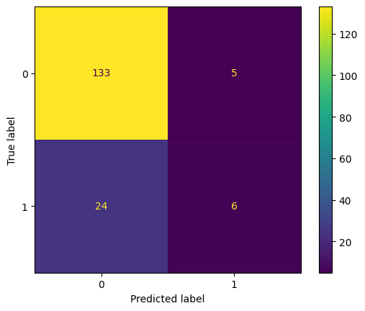
Threshold = 0.3
Threshold = 0.5
Threshold = .7
*Not enough data for interpretability, scaling threshold higher allows more conservative predictions

Slide 31
Model Comparison
Model Name | Description | Results | Pros | Cons
Decision Trees | Regression Classification | Accuracy: 0.84 | Interpretable Flexible as data updates | Overfitting risk Computationally demand
Support Vector Machines | Specialize in Binary Classification | Accuracy: 0.43 | Binary classification Memory efficient | Not convenient to update Interpretability
Gaussian Process | Regression Probability Classifications | Accuracy: 0.83 | Confidence levels or predictions Clusters | Interpretability
Notes:
INTERPRETABILITY MEANS EASABILITY TO UNDERSTAND HOW MODEL WORKS SO RESEARCHERS AND CONSERVATIONISTS CAN QUICKLY UNDERSTAND, USE, AND UPDATE MODEL WITH NEW DATA
Random forest is the best model for this problem!
All supervised models

Slide 32
Final Thoughts

Slide 33
What We Learned
Sourcing federally gathered natural data
Merging and Cleaning Datasets
Working with high dimensional climate data: features with coordinates in space and time
Time Series predictions
Using X-Arrays

Slide 34
Potential Next Steps
Detailed Bat Population Analysis:
Acquire more precise data on bat populations. Examine White-Nose Syndrome effects in depth.
Season-Specific Environmental Focus:
Prioritize environmental variables specific to the winter season. Winter is critical as it's when bats are most impacted by WNS.
Risk Assessment Model for Bat Populations
Create a second model that assesses the risk to local bat populations based on the output of the WNS spread model, incorporating factors like species susceptibility, population density, and health status
Future Development: User Interface
Future work will focus on developing an intuitive interface for public use, allowing non-experts to easily access and understand information about WNS status and bat population risks.
Notes:
Margo

Slide 35

Questions?

Slide 36
Reserve slides:

